Slide 1


Leif Bloomquist
Rethinking Art and the Machine
Tools For 8 Bit Music
@ THEMUSEUM – Kitchener, ON, Canada
December 11, 2011

Slide 2
Project Goals
Make the Commodore VIC-I (6560) chip’s distinctive sound available to electronic musicians.
Easy integration with sequencers, synthesizers, or tracking software using MIDI¹.
¹Musical Instrument Digital Interface

Slide 3
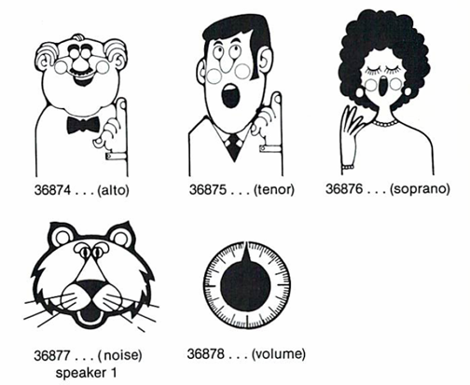
The VIC-20’s Voices
Square Wave output (except Noise)
Some overlap between voices

Slide 4
The MIDI Protocol
Defined in 1982.
Asynchronous Serial Interface at 31.25 Kbps.
Messages consist of a Status byte (bit #7 set) followed by Data bytes (usually two).
16 “Channels”.
Commands such as Note On, Note Off, Control Change, etc.

Slide 5
Typical MIDI Message
Status
byte
Data
bytes
9 | 1 | 3C | 40
Command
Channel

Slide 6
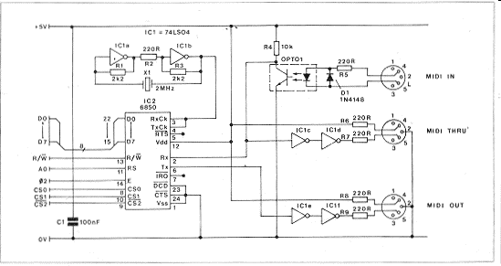
Hardware Schematic
From Electronics, the Maplin Magazine
http://members.lycos.co.uk/templarseries/maplin.html

Slide 7
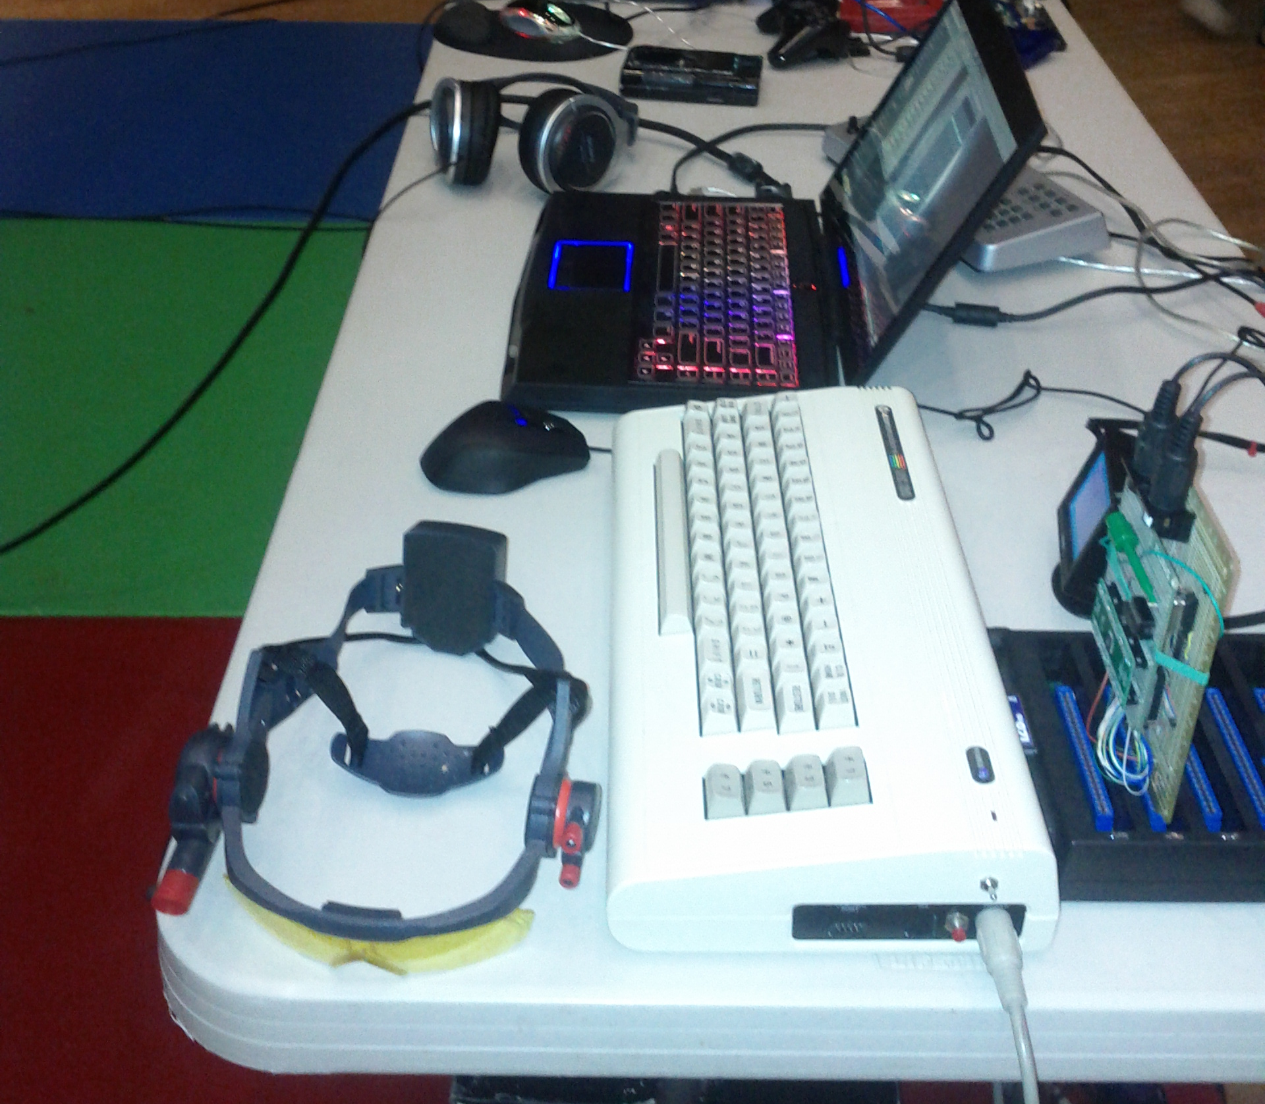
Prototype

Slide 8
Software
6502 Assembler
Cross-compiled using DASM²
² http://dasm-dillon.sourceforge.net/

Slide 9
Implementation
One MIDI Channel per Voice
Channel 1 = Alto (36874)
Channel 2 = Tenor (36875)
Channel 3 = Soprano (36876)
Channel 4 = Noise (36877)
Master Volume is set through Controller #7 (Coarse Volume) on any channel

Slide 10
Implementation (Continued)
Note On commands use a lookup table to match MIDI Note# to the closest match for that voice.
Controller #1 (Course Modulation) does a direct “POKE” to the corresponding Voice register.
Note Off, All Notes Off commands on a specific channel are used to silence that voice.

Slide 11
Left to Implement
MIDI “Running Status”
MIDI-Out (use the VIC keyboard to control external hardware)
Mono/Polyphony Modes that use multiple voices
PAL or NTSC lookup tables
Viznut’s waveforms

Slide 12
Next Steps
More sophisticated prototype including MIDI Out and autostart ROM
Small manufacturing run of cartridges – quantity and price TBD.

Slide 13
Credits
Hardware:
LD. Ball
Francois Leveille
Jim Brain
Software:
Leif Bloomquist
David Viens
“Viznut”

Slide 14
Demo Tune!
http://soundcloud.com/schema-factor/rethinking-art-and-the-machine

